Slide 1
CAR PRICE PREDICTION
By :- Group – 03 Vivek Prajapat (19114019) Ashish Ubana (18114005) Saurabh Kumar Gupta (19114010) Pradnesh Lachake (19114007)
Supervised By :- Dr. Devlina Chatterjee

Slide 2
Introduction of Problem
A Chinese automobile company “Geely Auto” aspires to enter the US market by setting up their manufacturing unit there and producing cars locally to give competition to their US and European counterparts.
For the same, they want to understand the factors on which the pricing of car depends.
Basically, they want to identify those differentiating parameters which are different for American and Chinese market, so that they can make their strategy accordingly.
Basic questions that they want to know:
Which variables are significant in predicting the price of a car?
How well those variables describe the price of a car?

Slide 3
Goals of Chinese Company
Using the given independent variables we have to build a model which can predict the price of cars. This will help management to understand car price variation with those independent variables.
With the help of model, the management can work on the design of cars, business strategies, etc to meet the price levels
Further, this would also be helpful in depicting the price dynamics in the new market.

Slide 4
Methodology
Summary of data and data visualization.
Start building model using uni-variate Linear Regression model, and then using multi-variate Linear Regression model.
Further using Recursive Feature Elimination (RFE) method we have selected our attributes for the building our model
Then on the basis of threshold p-values and VIF(Variance Inflation Factor) we have done backward elimination and have eliminated insignificant variables.

Slide 5
Description of Data
Source of Data :- UCI Machine Learning Repository
dataset :- https://archive.ics.uci.edu/ml/datasets/Automobile
Dependent Variable :- Price of car (Numeric)
Independent Variables :- There are a total of 25 independent variables.
Car_ID: Unique id of each observation (Interger)
Symboling: Its assigned insurance risk rating, A value of +3 indicates that the auto is risky, -3 that it is probably pretty safe.(Categorical)
carCompany: Name of car company (Categorical)
fueltype: Car fuel type i.e. gas or diesel (Categorical)
aspiration: Aspiration used in a car (Categorical)
doornumber: Number of doors in a car (Categorical)

Slide 6
Independent Variables :-
carbody: body of car (Categorical)
drivewheel: type of drive wheel (Categorical)
enginelocation: Location of car engine (Categorical)
wheelbase: Weelbase of car (Numeric)
carlength: Length of car (Numeric)
carwidth: Width of car (Numeric)
carheight: height of car (Numeric)
curbweight: The weight of a car without occupants or baggage. (Numeric)
enginetype: Type of engine. (Categorical)
cylindernumber: cylinder placed in the car (Categorical)
enginesize: Size of car (Numeric)
fuelsystem: Fuel system of car (Categorical)
boreratio: Boreratio of car (Numeric)

Slide 7
Independent Variables :-
stroke: Stroke or volume inside the engine (Numeric)
compressionratio: compression ratio of car (Numeric)
horsepower: Horsepower (Numeric)
peakrpm: car peak rpm (Numeric)
citympg: Mileage in city (Numeric)
highwaympg: Mileage on highway (Numeric)

Slide 8
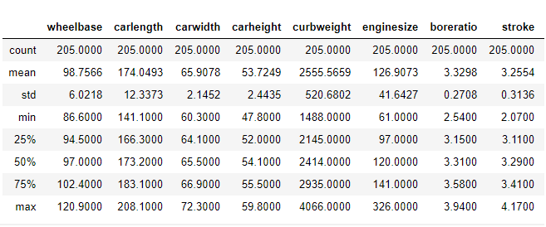
Description of Data

Slide 9
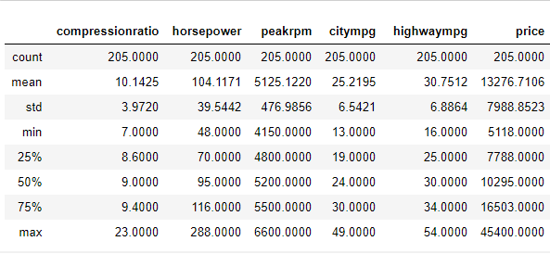
Description of Data
There is a large variation in the given variables by looking at the data description. So, we will normalize the data by Z score normalization.

Slide 10
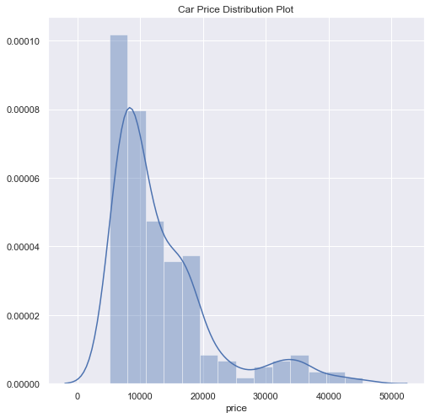
Car Price Distribution Plot
Car Price Distribution plot is positively skewed.
mean 13276.710571
std 7988.852332
min 5118.000000
25% 7788.000000
50% 10295.000000
75% 16503.000000
max 45400.000000

Slide 11
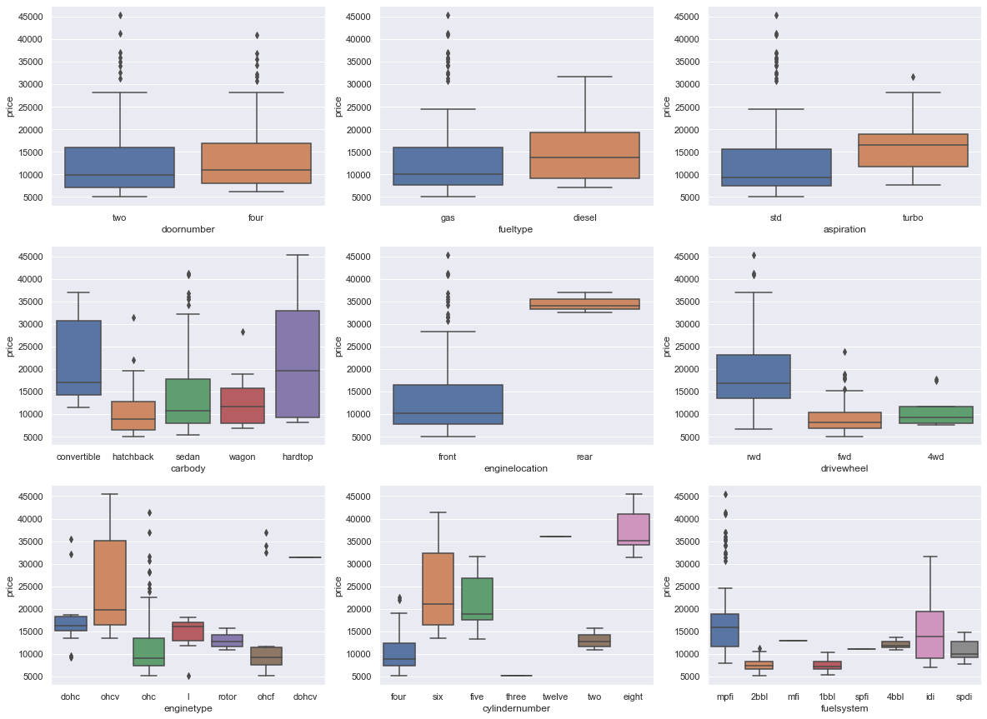
Door Number isn't affecting the price much.
The cars with fuel type as diesel are comparatively expensive than the cars with fuel type as gas.
Turbo charge cars relatively expansive than standard cars.
All the types of car body is relatively cheaper as compared to convertible car body.
The cars with rear engine location are way expensive than cars with front engine location.
Higher End cars seems to have rwd drive wheel.
Engine type ohcv comes into higher price range cars.
The price of car is directly proportional to no. of cylinders in most cases.

Slide 12
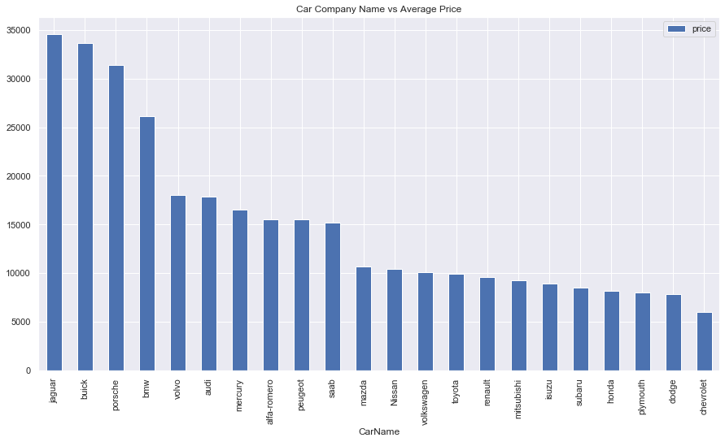
Based on average prices Jaguar, Buick and Porsche seems to have the highest average price.

Slide 13
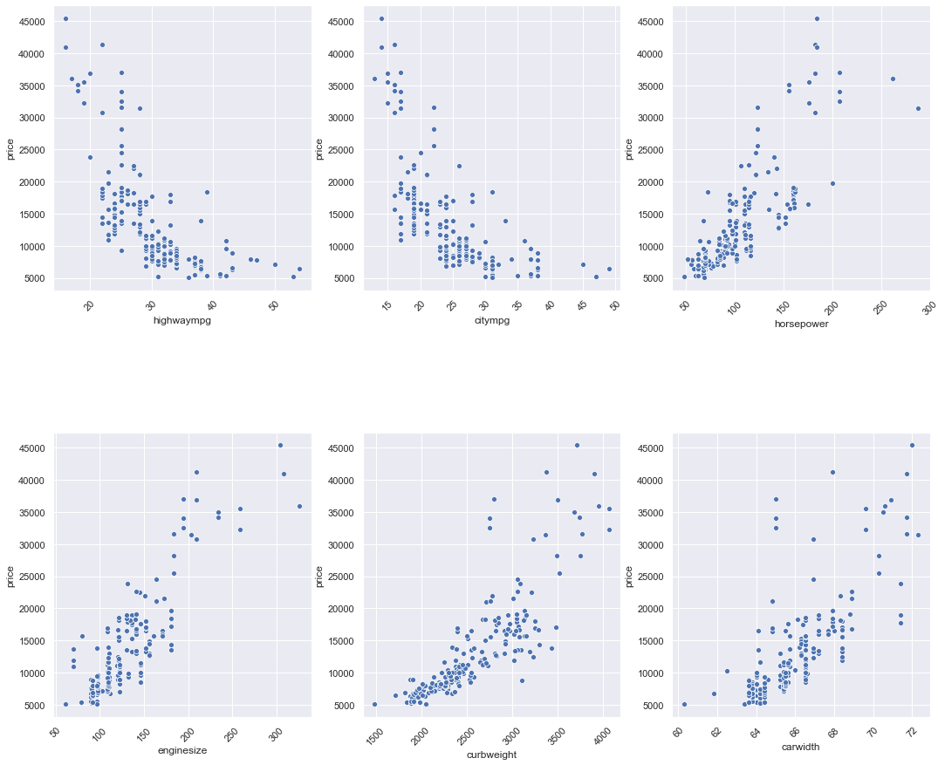
Scatter Plot
Based on the scatter plot of the horsepower, enginesize, curbweight, carwidth shows a positive correlation.
Highwaympg, citympg shows a negative correlation with the car price.

Slide 14
Linear Regression Model using Forward Selection of Features
We have started building our model with a single regressor with Independent variable, ‘horsepower’ being highly correlated with the dependent variable ‘car price’.
Model 1:
const 0.0000
Horsepower 0.8062
After building the model the R^2 value obtained is 0.65. In order to better explain the dependent variable we included some new independent variables in our model. These independent variables will be selected based on their correlation values with the price.
The second highly correlated variable, ‘curbweight’ is introduced in the model 2.
const 0.0000
horsepower 0.3581
curbweight 0.5898
The R^2 value for model 2 is 0.797.

Slide 15
Linear Regression Model using Forward Selection of Features
To further explain our dependent variable, we will add another highly correlated variable, ‘enginesize’.
Model 3:
const 0.0000
horsepower 0.2288
curbweight 0.3938
enginesize 0.3400
In model 3, we included horsepower, curbweight, enginesize and found R^2 to be 0.819.

Slide 16
Using just only top three highly correlated variables, we have been able to explain around 82% of the dependent variable.
But, there are 22 independent variables which have not been used to explain the dependent variable.
So, here we have a problem of omitted variable bias (OVB) in the model.
The OVB can be eliminated by introducing more independent variables to our model.
There are two approaches, either we could use forward selection or backward elimination method to build our model.
Since we have a lot of variables forward selection method is not a better choice. We have decided to build our model using Recursive Feature Elimination (RFE) method and VIF.

Slide 17
Recursive Feature Elimination (RFE)
Recursive Feature Elimination is basically a backward selection of the predictors.
This technique begins by building a model on the entire set of predictors and computing an importance score for each predictor.
The least important predictor(s) are then removed, the model is re-built, and importance scores are computed again. In practice, the analyst specifies the number of predictor subsets to evaluate as well as each subset’s size.
Therefore, the subset size is a tuning parameter for RFE. The subset size that optimizes the performance criteria is used to select the predictors based on the importance rankings.

Slide 18
Variance Inflation Factor (VIF)
A variance inflation factor (VIF) provides a measure of multicollinearity among the independent variables in a multiple regression model.
Detecting multicollinearity is important because while it does not reduce the explanatory power of the model, it does reduce the statistical significance of the independent variables.
A large VIF (generally greater than 5) on an independent variable indicates a highly collinear relationship to the other variables that should be considered or adjusted for in the structure of the model and selection of independent variables.

Slide 19
Model Building Criteria
The threshold p-value and VIF value is as follows:
P value greater than 0.05 (i.e. 95 percent of confidence).
VIF value greater than 5.
We will start with including every independent variable and then
We will drop the variable with high p-value and high VIF
We will drop the variable with highest p-value between variables with high p-value low VIF or low p-value high VIF
We will retain the variable with low p-value and low VIF

Slide 20
 | Model - 1 |  |  | Model - 2 |  |  | Model - 3
VARIABLE | Beta Value | p Values | VIF Values | Beta Value | p Values | VIF Values | Beta Value | p Values | VIF Values
const | 0.7074 | 0 |  | 0.7124 | 0 |  | 0.6736 | 0
curbweight | 0.247 | 0 | 9.06 | 0.248 | 0 | 9.06 | 0.2384 | 0 | 8.53
horsepower | 0.215 | 0 | 5.61 | 0.2324 | 0 | 4.69 | 0.2273 | 0 | 4.53
carwidth | 0.227 | 0 | 6.24 | 0.2328 | 0 | 6.15 | 0.2408 | 0 | 5.72
Cars_Category_TopNotch_Cars | 1.061 | 0 | 2.17 | 1.0502 | 0 | 2.14 | 1.0599 | 0 | 2.13
carbody_hardtop | -0.2211 | 0.303 | 1.45 | -0.2314 | 0.279 | 1.45 | -0.25 | 0.238 | 1.28
carbody_hatchback | -0.6016 | 0 | 6.15 | -0.6198 | 0 | 5.95 | -0.6311 | 0 | 3.76
carbody_sedan | -0.4691 | 0.002 | 9.73 | -0.4951 | 0.001 | 9.05 | -0.5123 | 0.001 | 5.24
carbody_wagon | -0.5865 | 0 | 3.48 | -0.6111 | 0 | 3.31 | -0.6269 | 0 | 2.36
enginetype_dohcv | -1.0254 | 0.006 | 1.84 | -0.9329 | 0.008 | 1.67 | -0.8773 | 0.01 | 1.6
enginetype_ohc | 0.126 | 0.061 | 5.97 | 0.1212 | 0.07 | 5.92 | -0.1104 | 0.088 | 5.65
enginetype_ohcv | -0.1968 | 0.105 | 1.63 | -0.2225 | 0.059 | 1.53 | -0.218 | 0.063 | 1.52
cylindernumber_five | -0.3815 | 0.022 | 2.82 | -0.3529 | 0.03 | 2.66 | -0.2894 | 0.03 | 1.97
cylindernumber_four | -0.4642 | 0 | 15.92 | -0.4483 | 0.001 | 15.27 | -0.3896 | 0 | 8.99
cylindernumber_six | -0.1381 | 0.322 | 4.73 | -0.0857 | 0.493 | 3.7
cylindernumber_twelve | -0.296 | 0.393 | 1.66
R-squared |  |  | 0.936 |  |  | 0.936 |  |  | 0.936
Adj R -squared |  |  | 0.929 |  |  | 0.929 |  |  | 0.929

Slide 21
 | Model - 4 |  |  | Model - 5 |  |  | Model - 6
VARIABLE | Beta Value | p Values | VIF Values | Beta Value | p Values | VIF Values | Beta Value | p Values | VIF Values
const | 0.5631 | 0 |  | 0.5665 | 0 |  | 0.4821 | 0
curbweight | 0.2474 | 0 | 8.51 | 0.2288 | 0.001 | 8.25 | 0.246 | 0 | 8.1
horsepower | 0.2179 | 0 | 4.17 | 0.2151 | 0 | 4.17 | 0.2289 | 0 | 4.13
carwidth | 0.2386 | 0 | 5.65 | 0.2397 | 0 | 5.65 | 0.2058 | 0 | 5.08
Cars_Category_TopNotch_ Cars | 1.0606 | 0 | 2.08 | 1.1121 | 0 | 1.83 | 1.1276 | 0 | 1.83
carbody_hardtop
carbody_hatchback | -0.5214 | 0 | 3.31 | -0.4954 | 0 | 3.1 | -0.4798 | 0 | 2.63
carbody_sedan | -0.4054 | 0 | 4.64 | -0.3789 | 0.001 | 4.33 | -0.3696 | 0.001 | 3.52
carbody_wagon | -0.5259 | 0 | 2.22 | -0.5137 | 0 | 2.2 | -0.5091 | 0 | 1.94
enginetype_dohcv | -0.8407 | 0.014 | 1.58 | -0.883 | 0.01 | 1.57 | -0.8214 | 0.016 | 1.54
enginetype_ohc | 0.1029 | 0.11 | 5.6
enginetype_ohcv | -0.1975 | 0.089 | 1.52 | -0.2098 | 0.072 | 1.51 | -0.1484 | 0.18 | 1.43
cylindernumber_five | -0.2793 | 0.036 | 1.93 | -0.2024 | 0.104 | 1.63
cylindernumber_four | -0.3811 | 0 | 8.09 | -0.3351 | 0 | 6.8 | -0.2608 | 0.001 | 5.76
cylindernumber_six
cylindernumber_twelve
R-squared |  |  | 0.935 |  |  | 0.934 |  |  | 0.932
Adj R -squared |  |  | 0.929 |  |  | 0.928 |  |  | 0.927

Slide 22
 | Model - 7 |  |  | Model - 8 |  |  | Model - 9
VARIABLE | Beta Value | p Values | VIF Values | Beta Value | p Values | VIF Values | Beta Value | p Values | VIF Values
const | 0.4472 | 0.001 |  | 0.4709 | 0.001 |  | 0.244 | 0.038
curbweight | 0.2449 | 0 | 8.1
horsepower | 0.2146 | 0 | 3.81 | 0.3021 | 0 | 2.72 | 0.3599 | 0 | 2.44
carwidth | 0.206 | 0 | 5.08 | 0.3523 | 0 | 2.22 | 0.3652 | 0 | 2.12
Cars_Category_ TopNotch_Cars | 1.1456 | 0 | 1.81 | 1.2141 | 0 | 1.73 | 1.2895 | 0 | 1.7
carbody_hardtop
carbody_hatchback | -0.4744 | 0 | 2.47 | -0.5316 | 0 | 2.4 | -0.4859 | 0 | 1.1
carbody_sedan | -0.3619 | 0.002 | 3.35 | -0.3839 | 0.001 | 3.35 | -0.3518 | 0.004 | 1.22
carbody_wagon | -0.5038 | 0 | 1.89 | -0.423 | 0.002 | 1.71 | -0.4023 | 0.003 | 1.02
enginetype_dohcv | -0.7421 | 0.028 | 1.49 | -1.2424 | 0 | 1.24 | -1.445 | 0 | 1.22
enginetype_ohc
enginetype_ohcv
cylindernumber_five
cylindernumber_four | -0.2382 | 0.002 | 5.66 | -0.2504 | 0.002 | 5.66
cylindernumber_six
cylindernumber_twelve
R-squared |  |  | 0.931 |  |  | 0.924 |  |  | 0.918
Adj R -squared |  |  | 0.927 |  |  | 0.919 |  |  | 0.914

Slide 23
 | Model - 10 |  |  | Model - 11
VARIABLE | Beta Value | p Values | VIF Values | Beta Value | p Values | VIF Values
const | -0.0748 | 0.057 |  | -0.0925 | 0.009
curbweight
horsepower | 0.3837 | 0 | 2.31 | 0.3847 | 0 | 2.28
carwidth | 0.339 | 0 | 2.08 | 0.3381 | 0 | 2.07
Cars_Category_ TopNotch_Cars | 1.3063 | 0 | 1.46 | 1.3179 | 0 | 1.45
carbody_hardtop
carbody_hatchback | -0.1738 | 0.004 | 1.1 | -0.1565 | 0.006 | 1.1
carbody_sedan
carbody_wagon | -0.0792 | 0.315 | 1.02
enginetype_dohcv | -1.4904 | 0 | 1.22 | -1.5033 | 0 | 1.22
enginetype_ohc
enginetype_ohcv
cylindernumber_five
cylindernumber_four
cylindernumber_six
cylindernumber_twelve
R-squared |  |  | 0.913 |  |  | 0.912
Adj R -squared |  |  | 0.909 |  |  | 0.909

Slide 24
Model Insights
At Model 9 we have seven variable with adj R^2 value 0.914.
The target is to explain maximum variability using minimum variable.
So we dropped carbody_sedan by preliminary data visualization, p-value and correlation value and checking if there is substantial drop in R^2 value.
After dropping the variable carbody_sedan, there is no substantial drop in R^2 value (0.05). So, we will proceed with dropping carbody_sedan.
It results in increase in p-value of carbody_wagon (p-value 0.315). The reason behind increment of p value of this variable could be a negative correlation between carbody_sedan and carbody_wagon.

Slide 25
Conclusion
The R2 score of model 11 is 0.912. Hence, we can say that our model is good enough to predict the Car prices using below predictor variables
horsepower
carwidth
Cars_Category_TopNotch_Cars
carbody_hatchback
enginetype_dohcv
Carprice=−0.0925+0.3847×horsepower+0.3381×carwidth+1.3179×Carscategorytopnotchcars−0.1565×carbodyhatchback−1.5033×enginetypedohcv

Slide 26
Thank You

